Slide 1
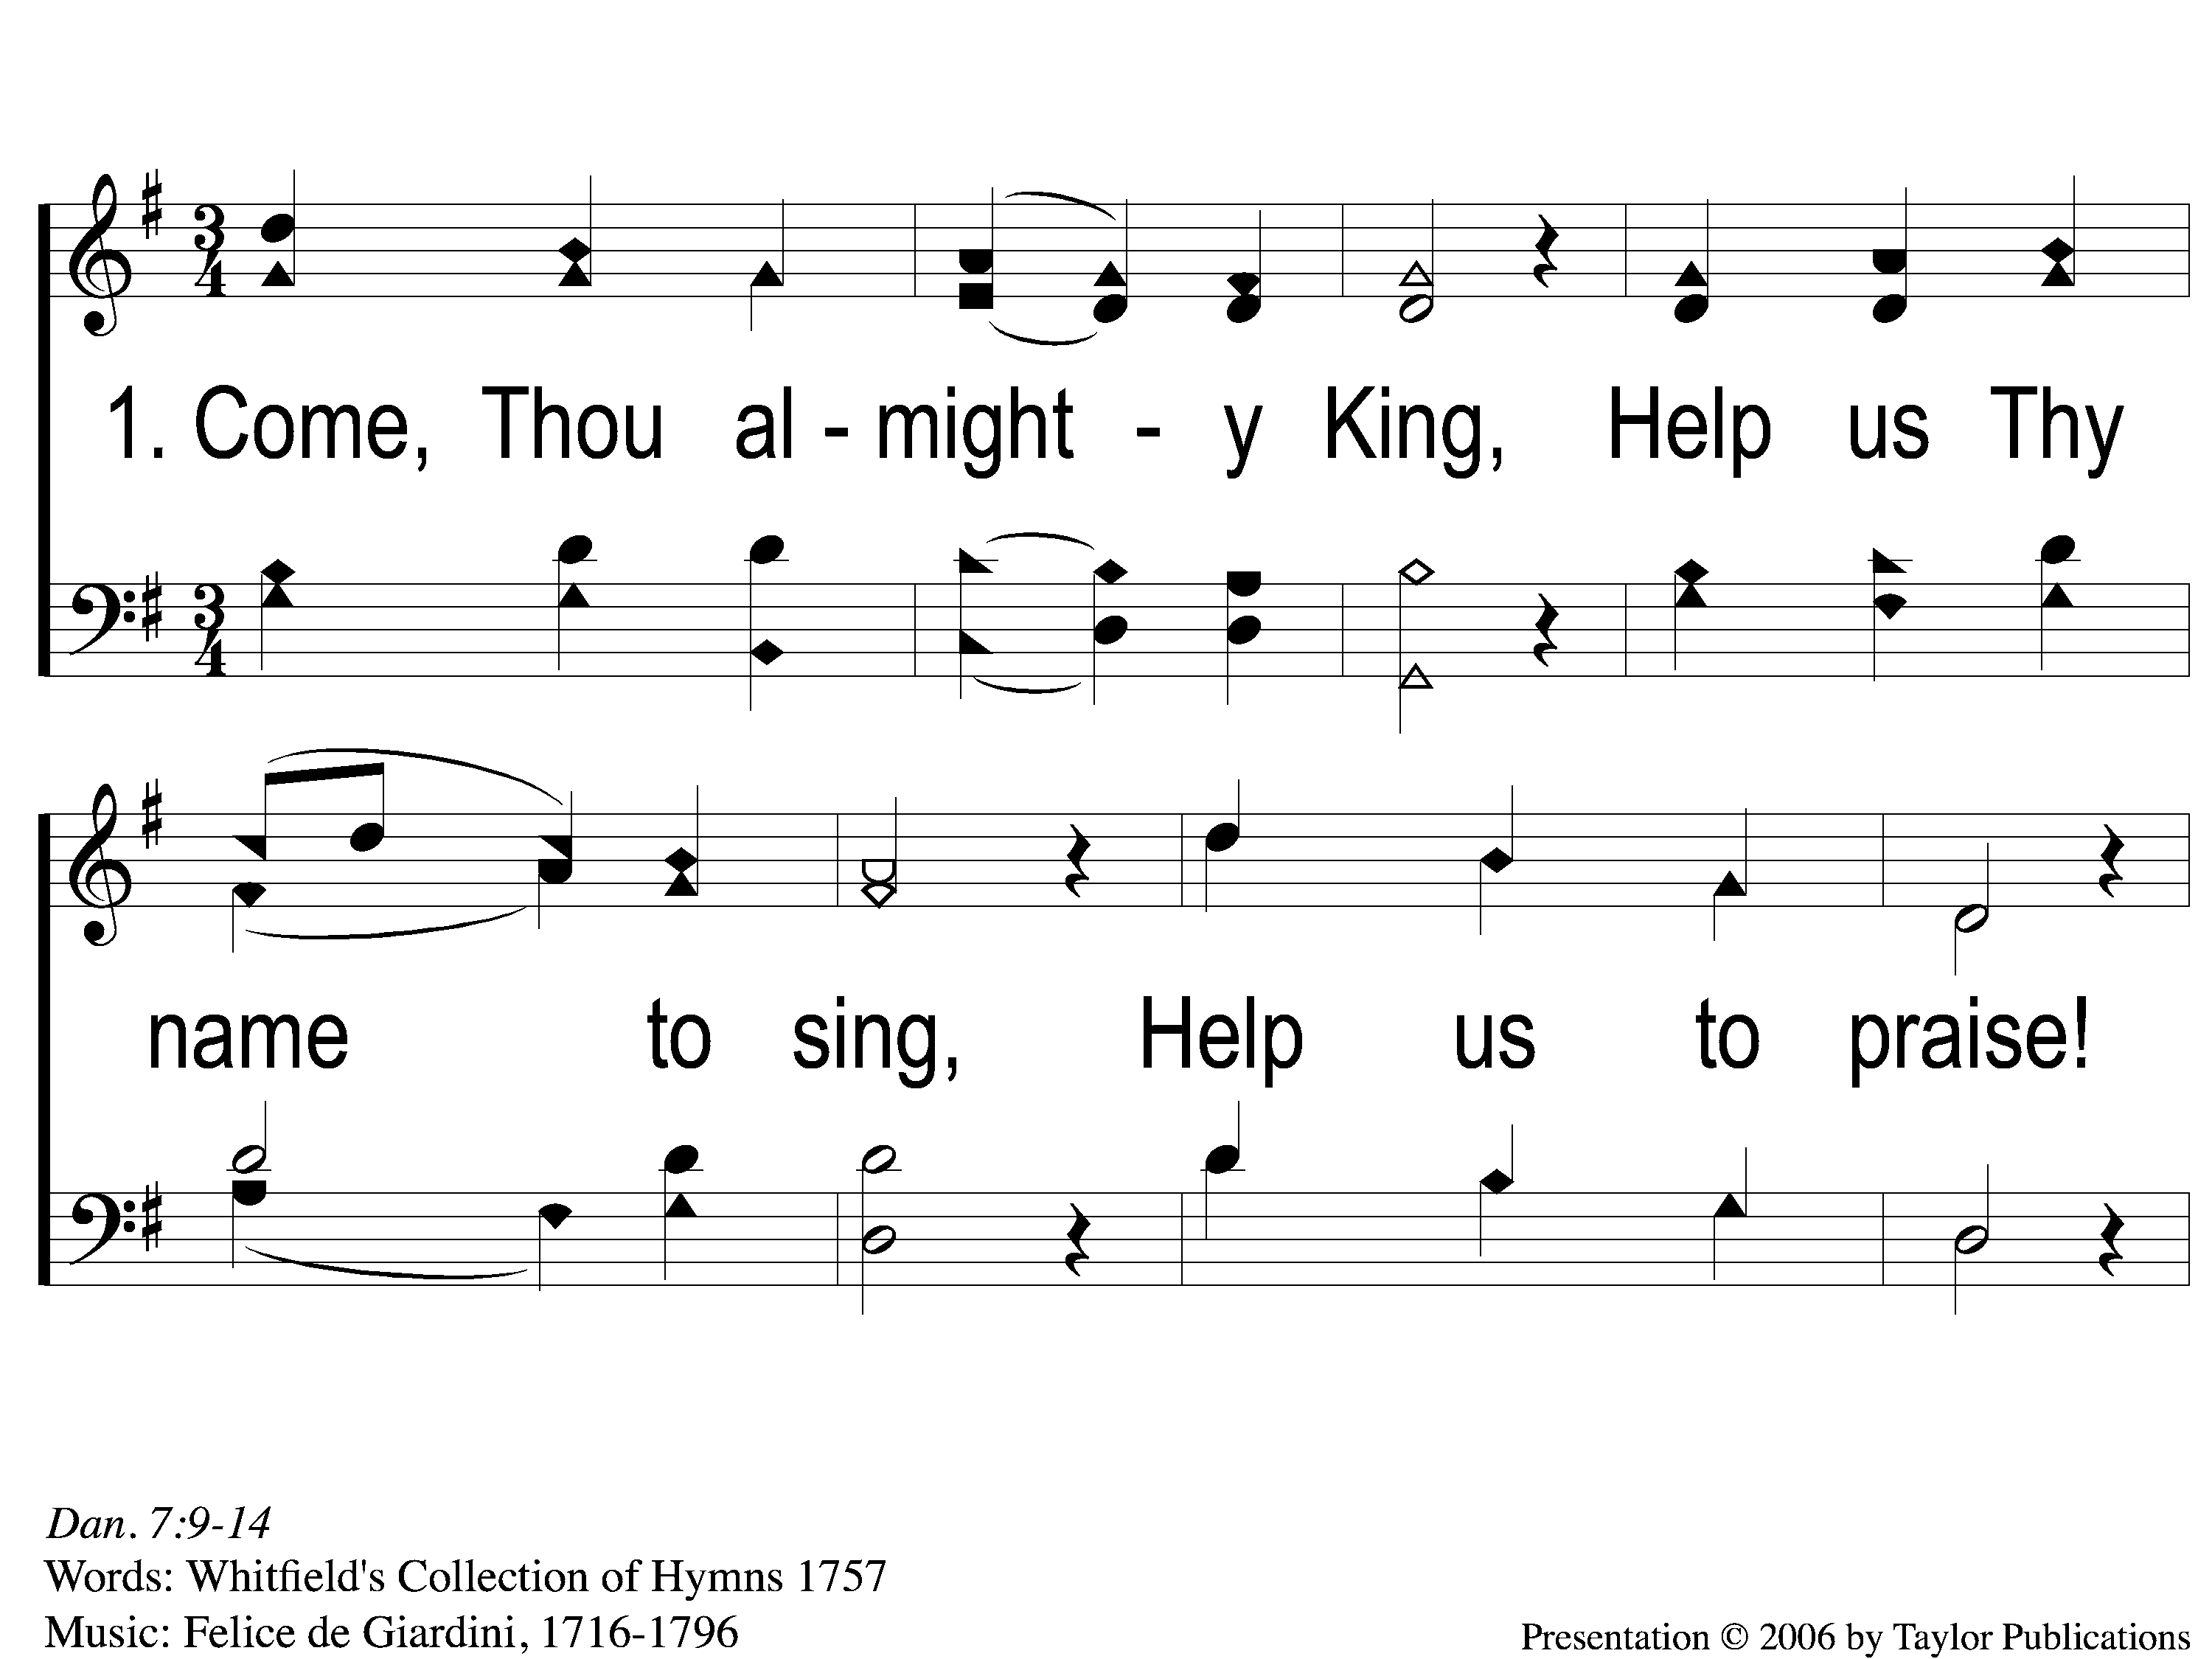
1-1 Come Thou Almighty King
Come, Thou Almighty King
67

Slide 2
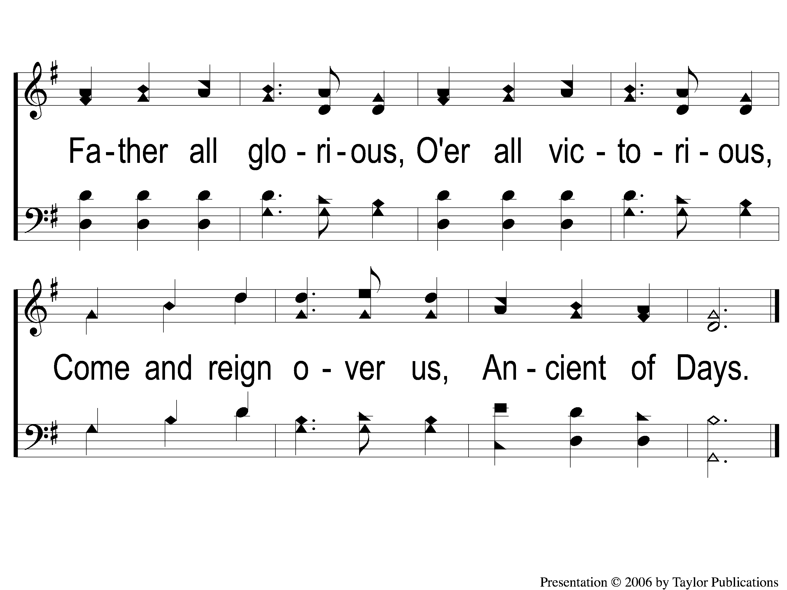
1-2 Come Thou Almighty King
Come, Thou Almighty King
67

Slide 3
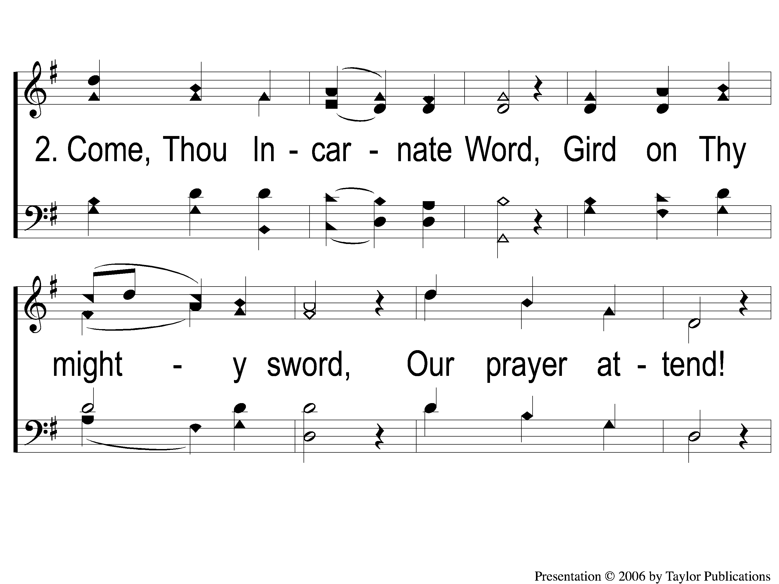
2-1 Come Thou Almighty King
Come, Thou Almighty King
67

Slide 4
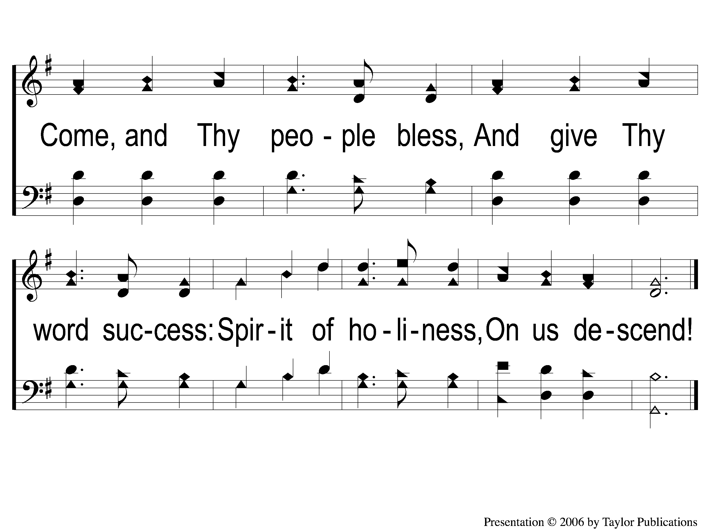
2-2 Come Thou Almighty King
Come, Thou Almighty King
67

Slide 5
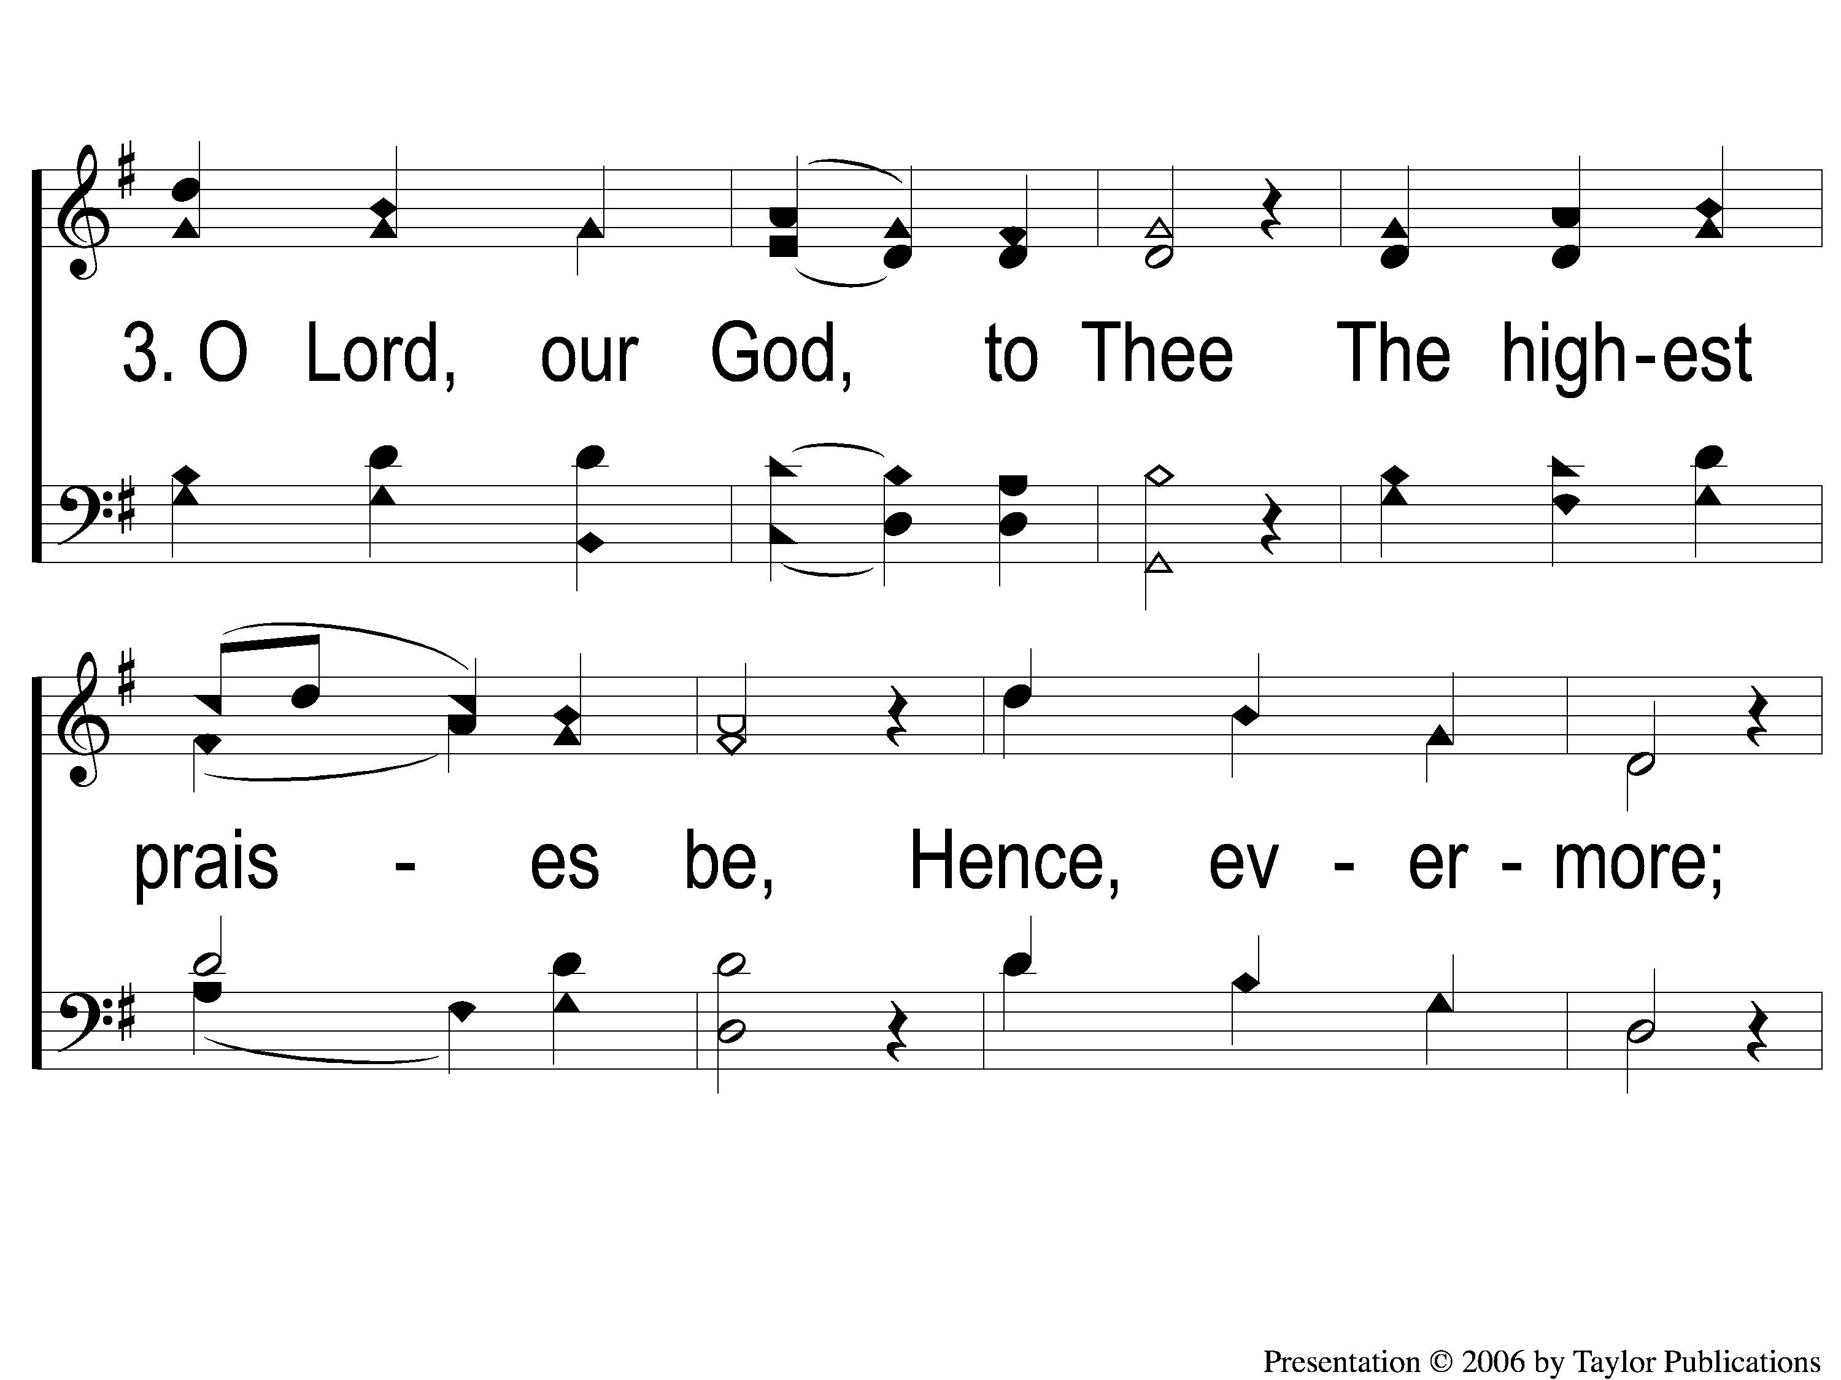
3-1 Come Thou Almighty King
Come, Thou Almighty King
67

Slide 6
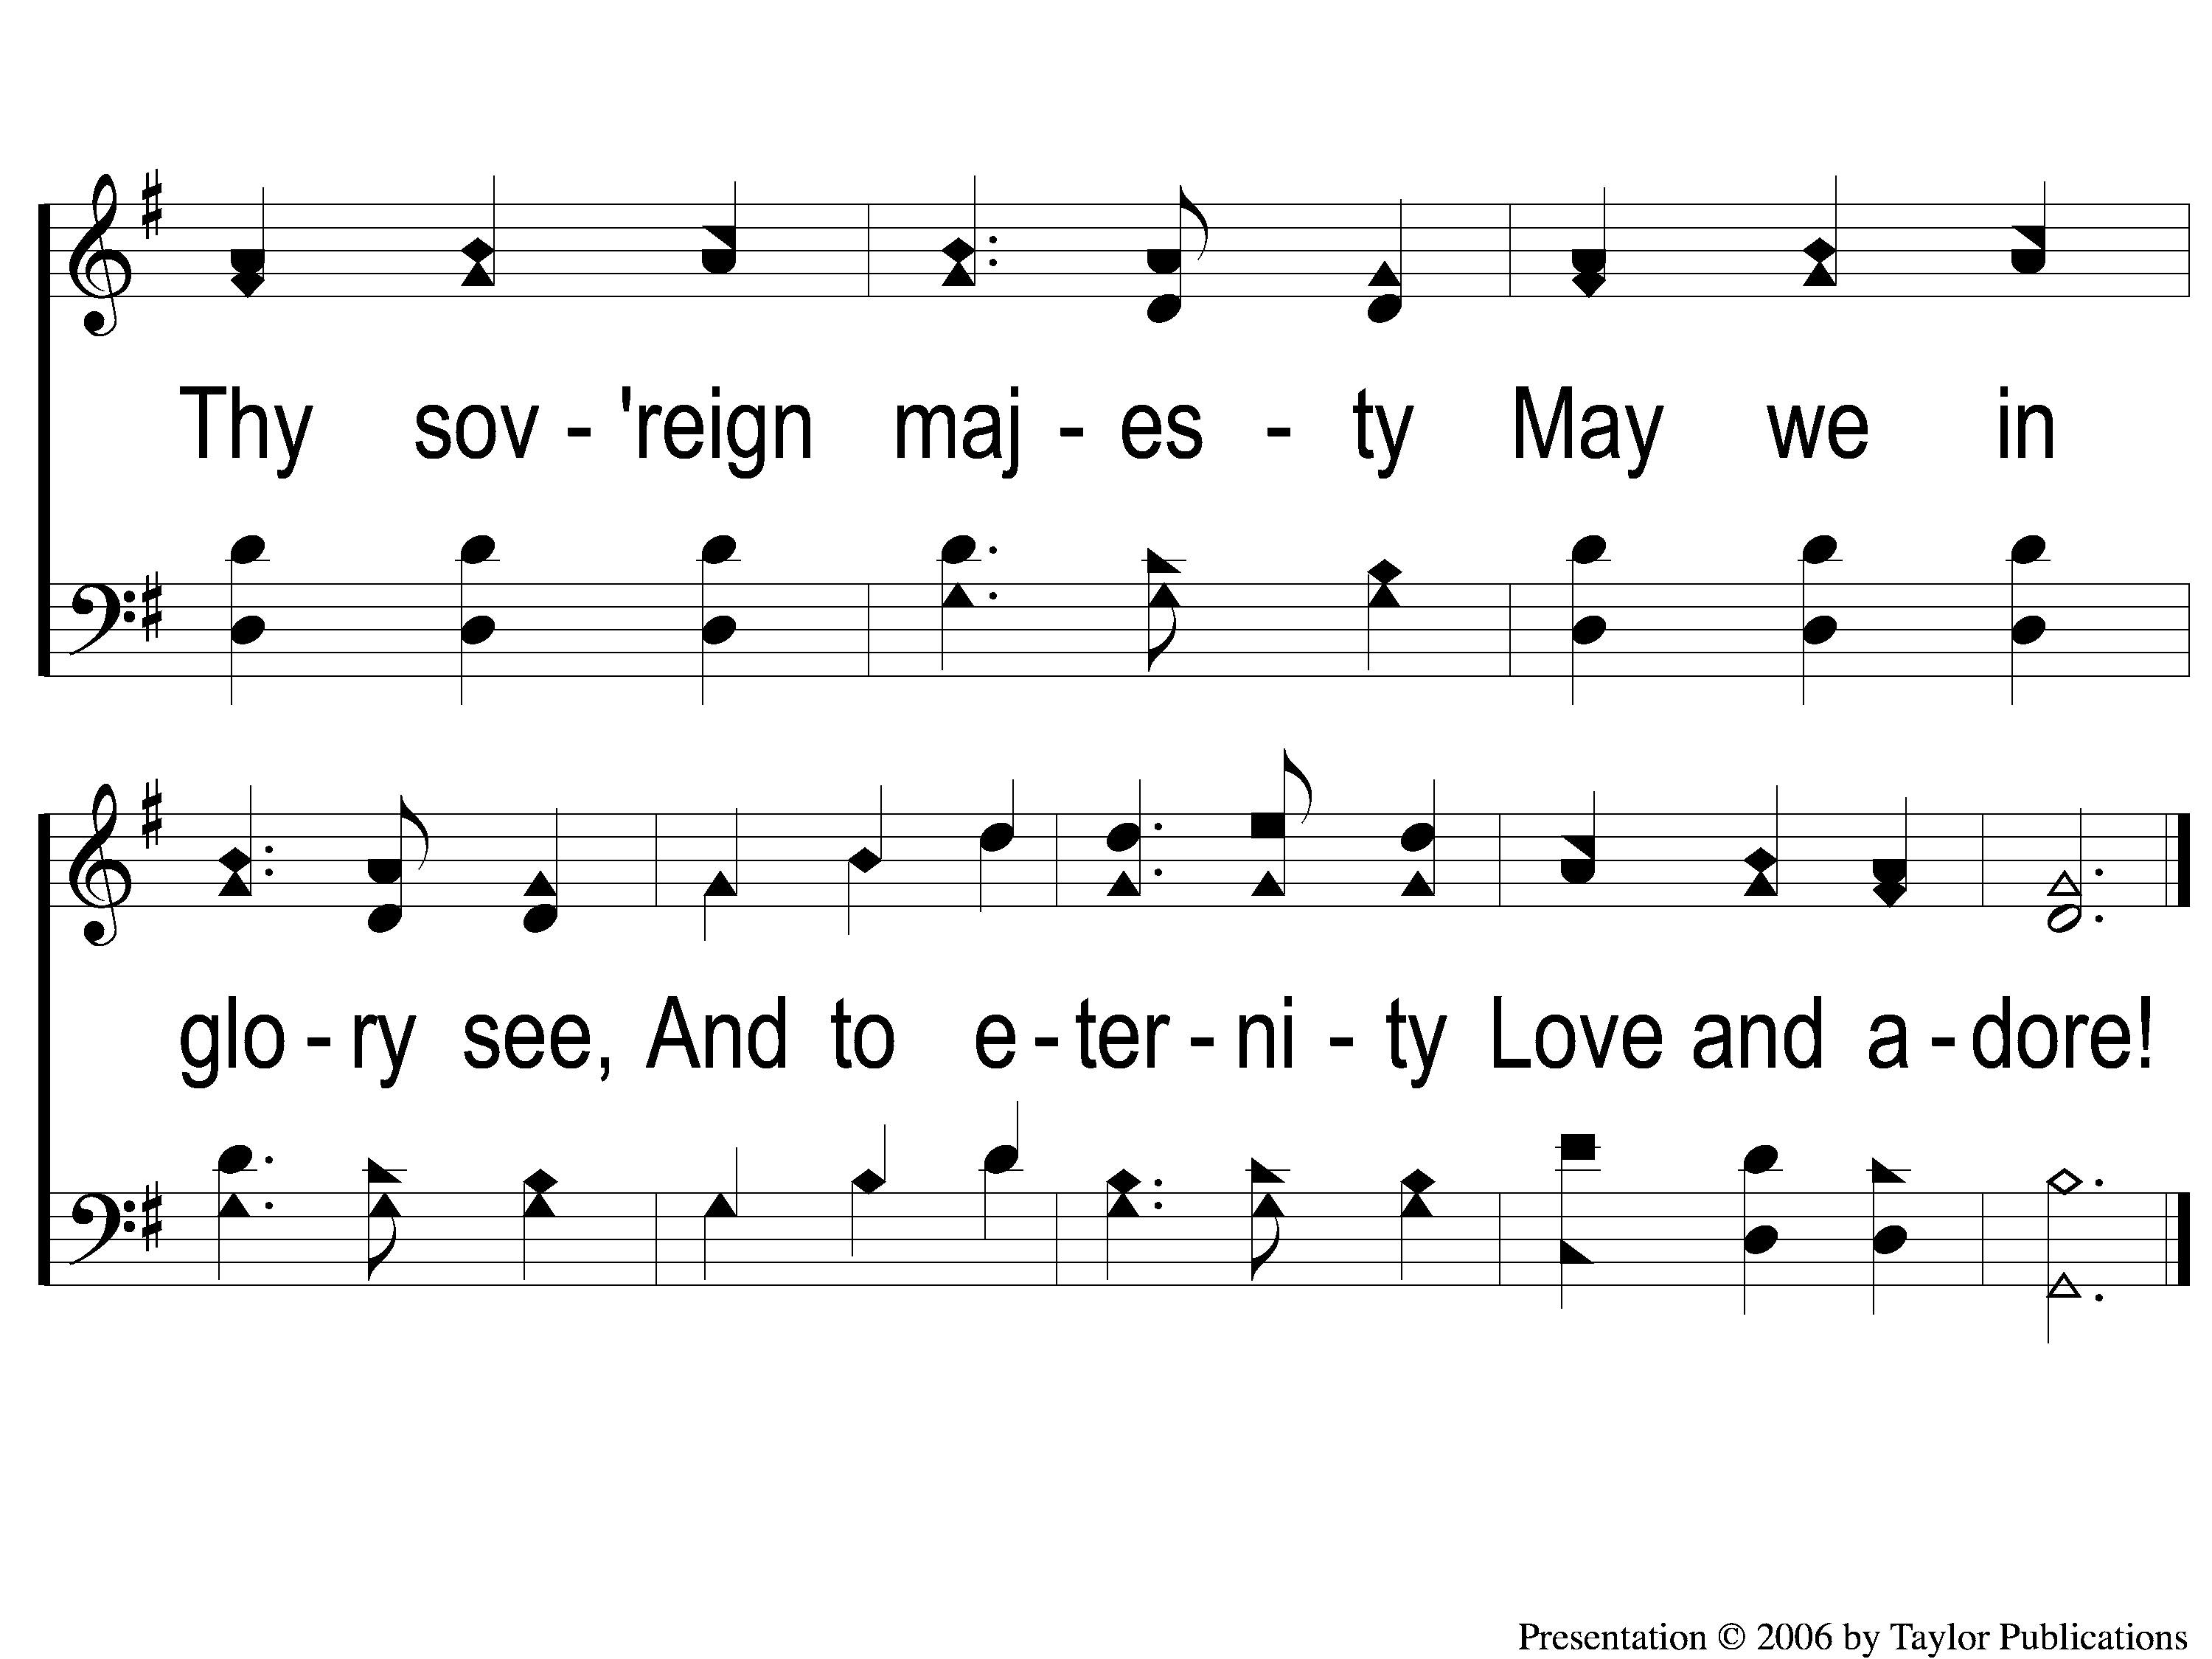
3-2 Come Thou Almighty King
Come, Thou Almighty King
67

